Slide 1


INSTITUTE FOR ADVANCED COMPUTING AND SOFTWARE DEVELOPMENT AKURDI,PUNE
Intrusion detection system with ossec (HIDS) and monitoring with splunk
Group No.24
Eti Saraswat (233449)
Jui Mulik (233450)
Project Guide Centre Coordinator Mr Kartik Awari Mr Rohit Puranik

Slide 2
Contents
Introduction
HIDS
Why OSSEC??
Prerequisites
Architecture
OSSEC Server -Agent
Advantages and Disadvantages
Features
Why Splunk??
Splunk Forwarder
Implementation
Conclusion
References

Slide 3
Introduction
OSSEC, which stands for Open Source HIDS SECurity, is a free and open-source host-based intrusion detection system that can be used to monitor anywhere from one to thousands of servers in a server/agent mode.
It performs log analysis, rootkit detection, time-based alerting, integrity checking and active response, essentially allowing you to be able to centrally manage and multiple systems from one area.

Slide 4
HIDS
A host-based intrusion detection system (HIDS) is a system that monitors a computer system on which it is installed to detect an intrusion and/or misuse, and responds by logging the activity and notifying the designated authority.
A HIDS can be thought of as an agent that monitors and analyzes whether anything or anyone, whether internal or external, has circumvented the system’s security policy.

Slide 5
Why OSSEC ?
OSSEC is a scalable, multi-platform, open source Host-based Intrusion Detection System (HIDS).
OSSEC has a powerful correlation and analysis engine, integrating log analysis, file integrity monitoring, Windows registry monitoring, centralized policy enforcement, rootkit detection, real-time alerting and active response.

Slide 6
Prerequisites
Operating Systems
linux -Debian 10 (OSSEC-SERVER)
linux -Debian 10 (OSSEC-AGENT)
linux -Debian 10 (SPLUNK)

Slide 7
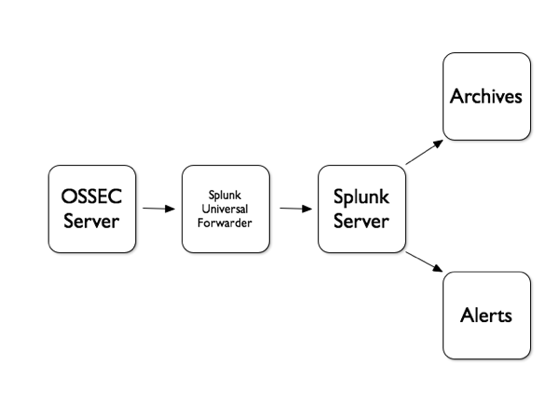
Architecture

Slide 8
OSSEC Server
OSSEC (Open Source HIDS SECurity) is a free, open-source host-based intrusion detection system (HIDS).
It performs log analysis, integrity checking, Windows registry monitoring, rootkit detection, time-based alerting, and active response.

Slide 9
OSSEC Agent
The agent is a small program, or collection of programs, installed on the systems to be monitored. The agent will collect information and forward it to the manager for analysis and correlation.
Agents do not send alerts to the manager, they only send the raw logs.

Slide 10
Advantages
OSSEC is an open source host intrusion prevention and detection system.
OSSEC is highly customizable, because it is open source.
It’s free. Because it’s an open source software. But if we need any corporate customization then it going to take some charges which is negotiable.
OSSEC can be operated through multiplatform like windows, UNIX, Linux, Solaris etc.

Slide 11
Disadvantages
Difficulty in upgrades between versions.
OSSEC comes with default rules and they are overwritten on every upgrade.
Coordinating pre-shared keys can be problematic.

Slide 12
Features
Log analysis
File Integrity checking (Unix and Windows)
Registry Integrity checking (Windows)
Host-based anomaly detection (for Unix – rootkit detection)
Active response
Alerting

Slide 13
Why Splunk??
Integrating OSSEC server with Splunk provides a powerful and comprehensive approach to security monitoring, threat detection, and incident response, while Splunk provides a centralized platform for collecting, analyzing, and visualizing security-related data.
Combining these two solutions can enhance your organization's security posture and improve your ability to detect and respond to threats effectively.

Slide 14
Splunk
Splunk is a powerful and widely used software platform that specializes in collecting, indexing, searching, and analyzing machine-generated data.
Splunk is commonly used for log management, security information and event management (SIEM), monitoring, and data analysis across a wide range of industries.

Slide 15
Splunk Forwarder
Splunk Forwarder, often referred to as "Splunk Universal Forwarder," is a lightweight component of the Splunk platform used for data collection and forwarding.
It is specifically designed to gather data from various sources, such as log files, metrics, and other machine-generated data, and then send that data to a central Splunk instance (usually a Splunk indexer) for indexing, search, and analysis.

Slide 16
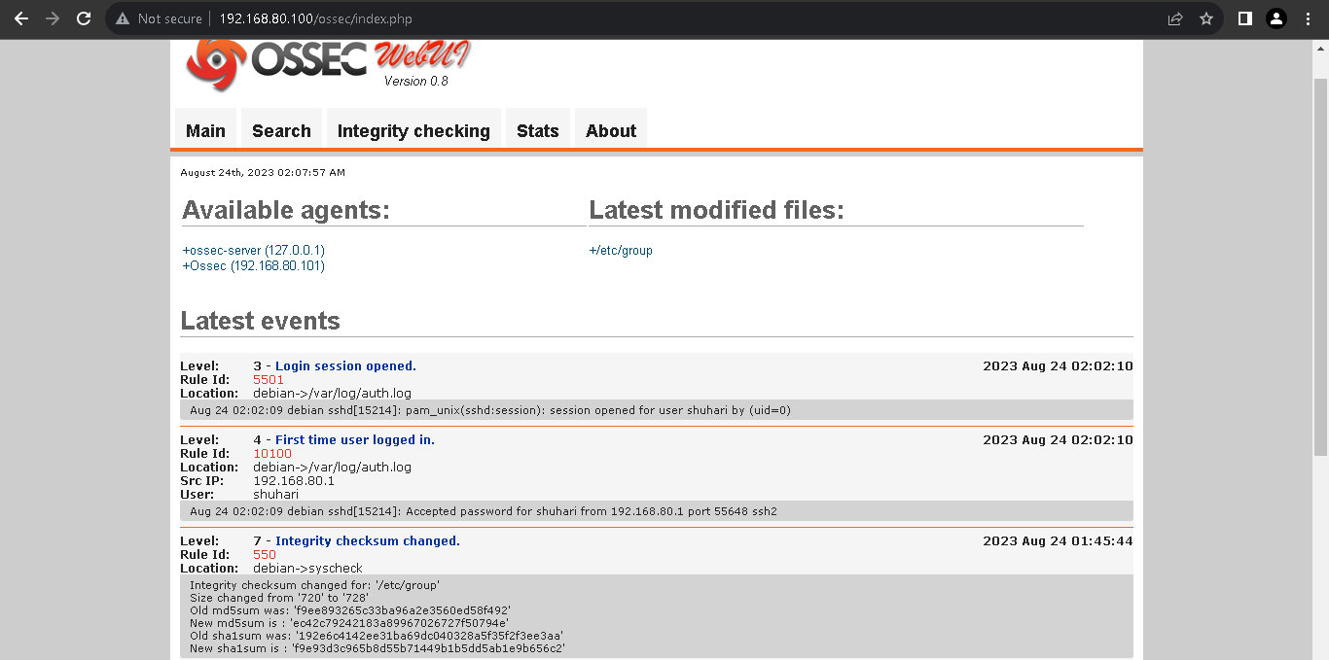
Ossec-server –Agent Setup

Slide 17
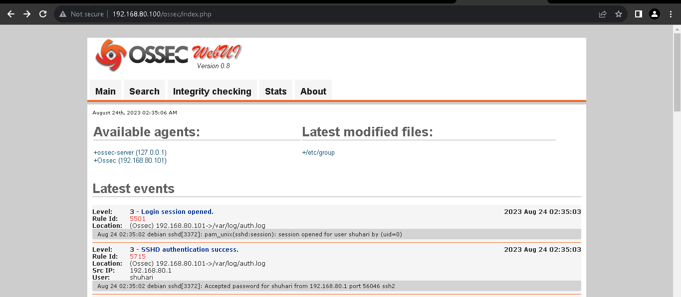
Authentication logs

Slide 18
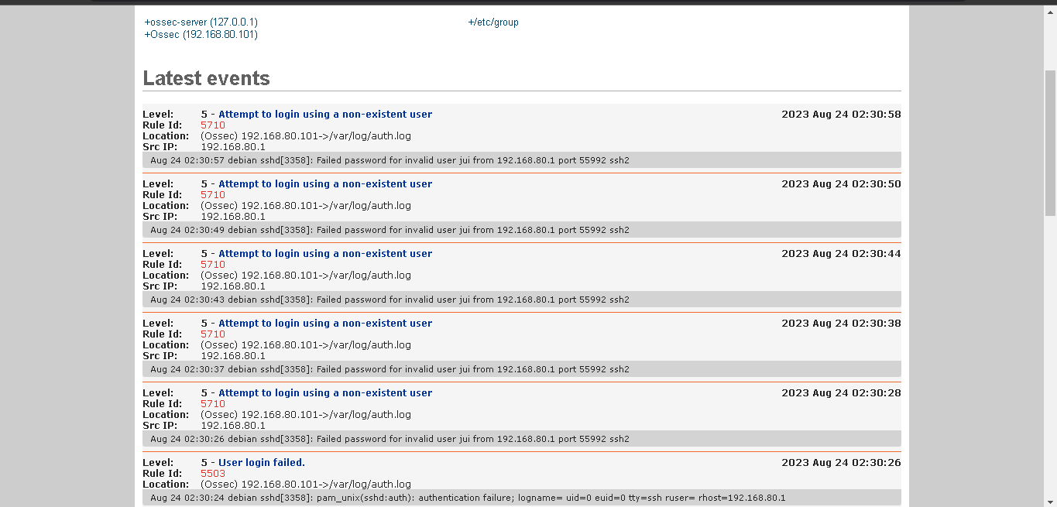
Failed logins

Slide 19
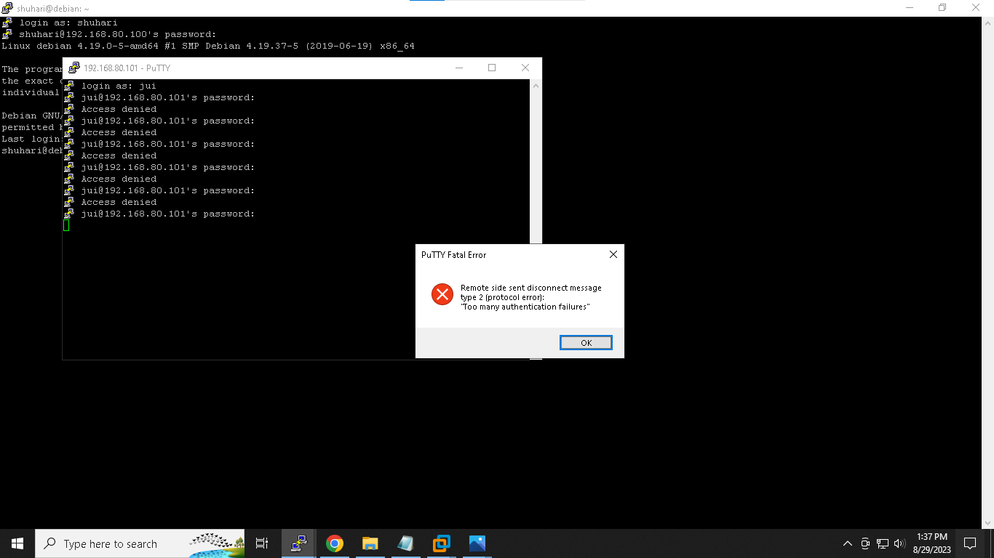
IP Blocked After Too Many Failed Login

Slide 20
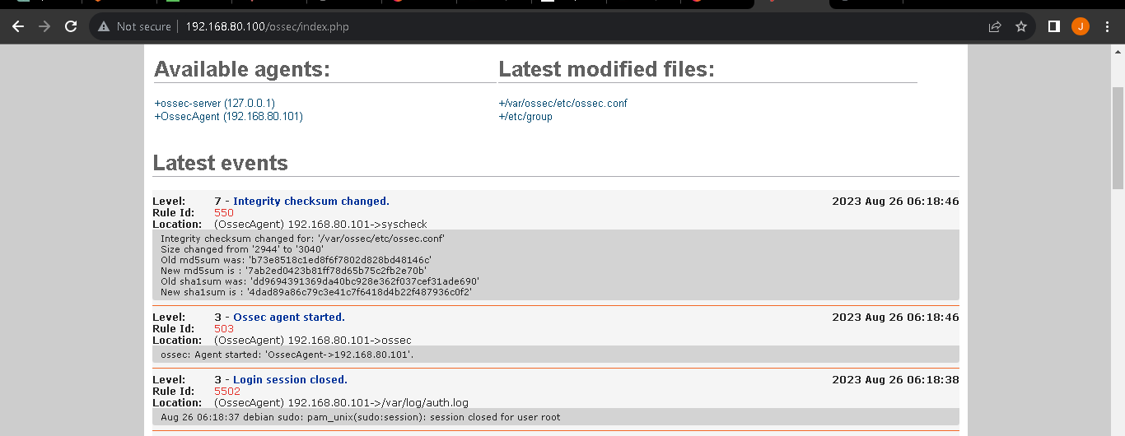
File Integrity Checking

Slide 21
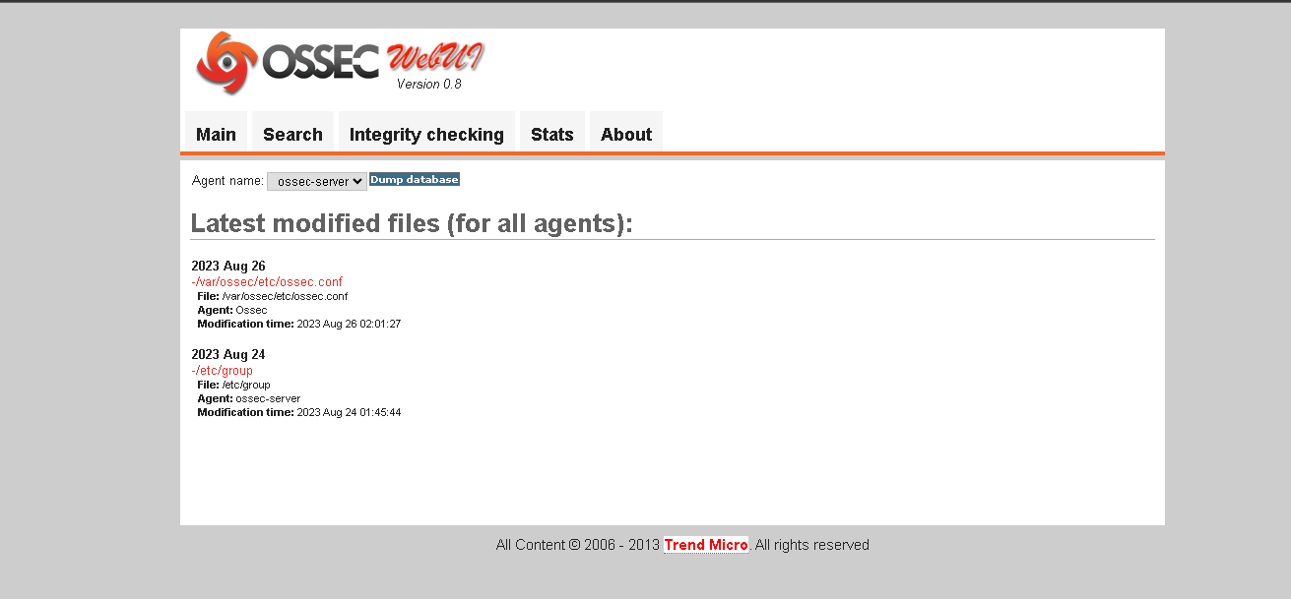
History of Integrity Checking

Slide 22
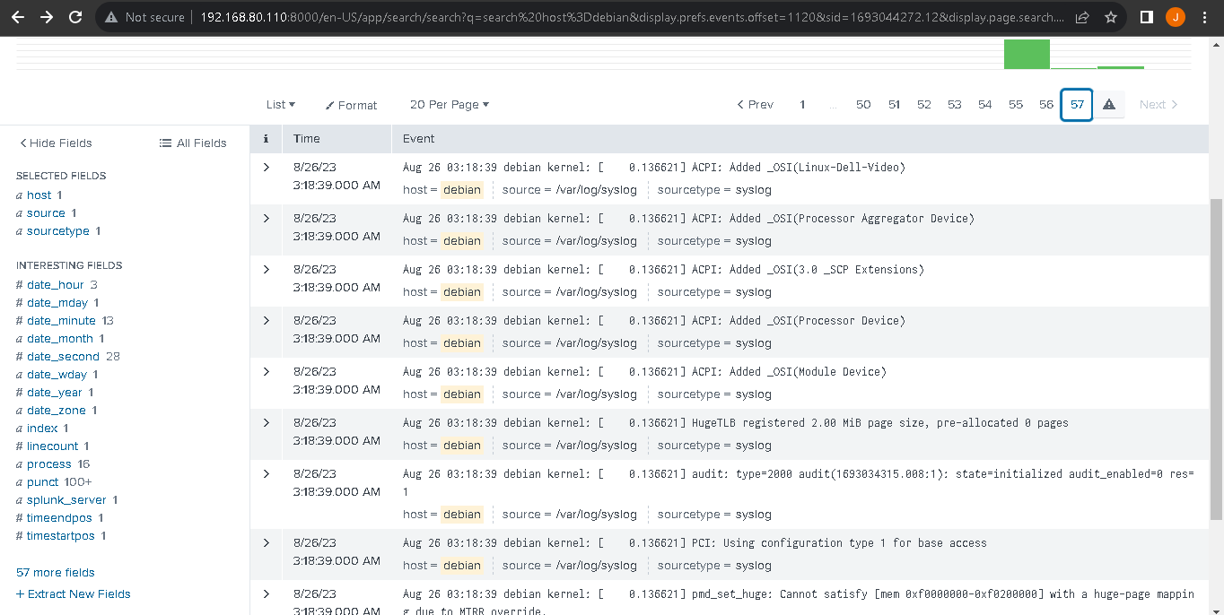
Monitoring with splunk

Slide 23
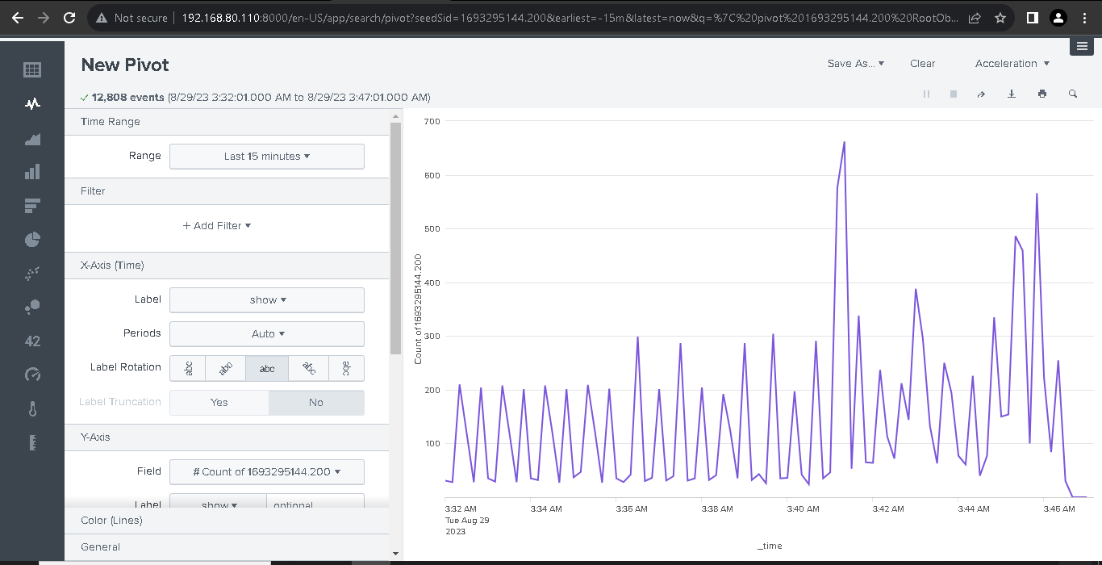
Graphical Representation

Slide 24
Conclusion
Server security is as paramount as network security because servers often hold a great deal of an organization’s vital information.
If a server is compromised, all of its contents may become available for the attacker to steal or manipulate at will.
This can lead to heavy losses in business and the defamation of an organization. To ensure your servers are monitored in a dedicated manner, we need a solution, which OSSEC is capable of.

Slide 25
References
Links:
https://www.talentica.com/blogs/hids-implementation-using-ossec/
https://blog.opstree.com/2022/01/18/host-based-intrusion-detection-using-ossec/
Book:
OSSEC HIDS host based intrusion detection guide by- Andrew Hay, Daniel Cid (Creator of OSSEC), Rory Bray

Slide 26


